Slide 1
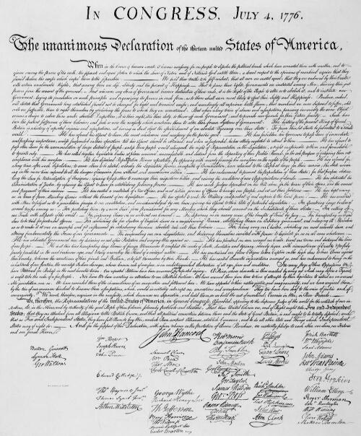
The Declaration of Independence

Slide 2
Any information that you need for your notes will be in red.

Slide 3
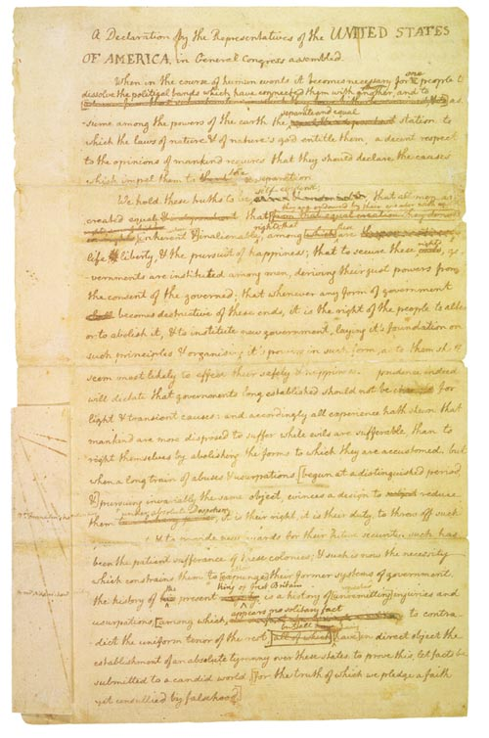
Jefferson is responsible for writing the first draft of the Declaration. This is an image of this first draft.

Slide 4
Take a look at some of the revisions on the first draft.
self-evident,
We hold these truths to be ^sacred & undeniable; that all Men are created equal & independent; that
they are endowed by their creator with
^from that equal creation they equal rights, some of which are derive in rights

Slide 5
Jefferson then presented his draft to Congress who created the final draft.
Take a look at some of Jefferson’s writing that Congress omitted.
This piratical warfare, the opprobrium of INFIDEL powers, is the warfare of the CHRISTIAN king of Great Britain. Determined to keep open a market where MEN should be bought & sold, he has prostituted his negative for suppressing every legislative attempt to prohibit or to restrain this execrable commerce.

Slide 6
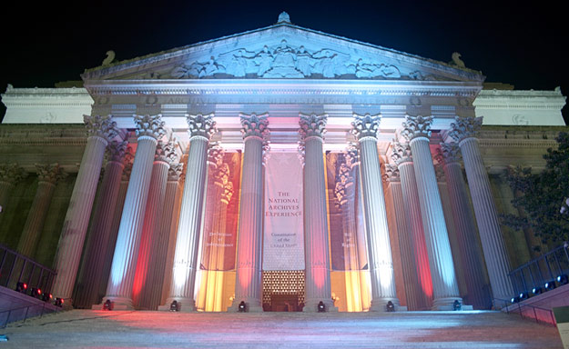
The copy of the Declaration of Independence in the National Archives is neither Jefferson’s draft or the draft from Congress

Slide 7
The draft in the National Archives is a third version which was handwritten after revisions and the adoption of the original on July 4. It was signed on July 19, 1776.
FIRST DRAFT | REPORTED DRAFT | ENGROSSED COPY
A Declaration by the Representatives of the United States of America in general Congress assembled. | A Declaration by the Representatives of the UNITED STATES OF AMERICA in General Congress assembled. | In Congress, July 4,1776. The unanimous Declaration of the thirteen United States of America.

