Slide 1
For Whom the Bell Tolls

Slide 2
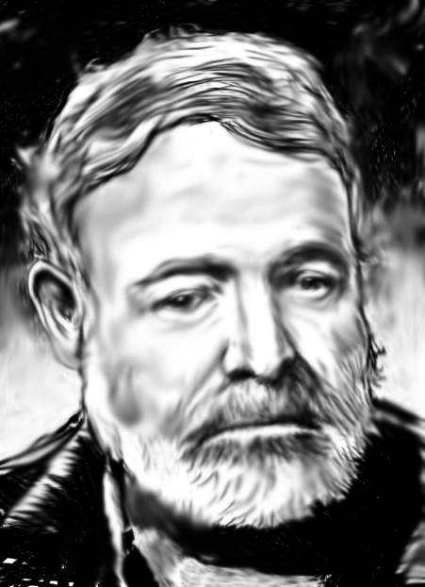
Ernest Hemingway
Be sure that you know about the author from your notes and the film.

Slide 3
No man is an island- John Donne
No man is an island, entire of itself; every man is a piece of the continent, a part of the main; if a clod be washed away by the sea, Europe is the less, as well as if a promontory were, as well as any manner of thy friends or of thine own were; any man’s death diminishes me, because I am involved in mankind. And therefore, never send to know for whom the bell tolls, it tolls for thee.

Slide 4
The Spanish Civil War
In 1936 and 1937 Hemingway was sent to Spain to cover the Spanish Civil War. He also wrote this novel while there. The war started in 1936.
He raised money for the Loyalist cause by giving speeches and writing.
This war was really the first battle of World War II. The Nazi, fascism, ideals were battling against democracy. Many men from other countries, like Robert Jordan, joined and fought with the Loyalist.

Slide 5
The introduction style of Hemingway
Hemingway begins Chapter One in the middle of the plot rather than beginning by introducing the characters and the setting.
The narrator is simply referred to as “he” until several pages into the text.

