Slide 1
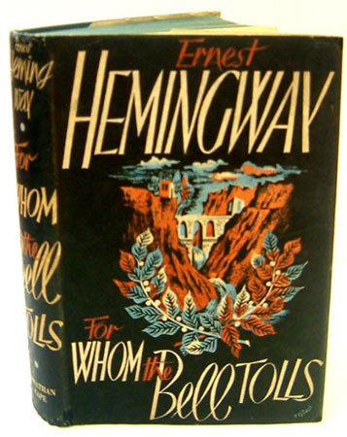

Slide 2
Publication History
This novel was released in 1940 after Hemingway returned from Spain
It is considered by many critics to be his greatest work
It has sold more copies than any other Hemingway novel
"For Whom the Bell Tolls." Encyclopedia Britannica. 2010. Encyclopedia Britannica Online. 10 Nov. 2010

Slide 3
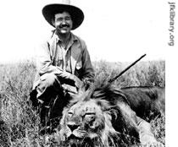
About the Author
Born in Chicago in 1899.
His father was a doctor, and he was raised in a wealthy manner.
His father was strict but taught him to build fires, cook outdoors, use an axe, fish, make bullets, and mount small animals
He received a shotgun for for his twelfth birthday
He was an avid hunter from then on

Slide 4
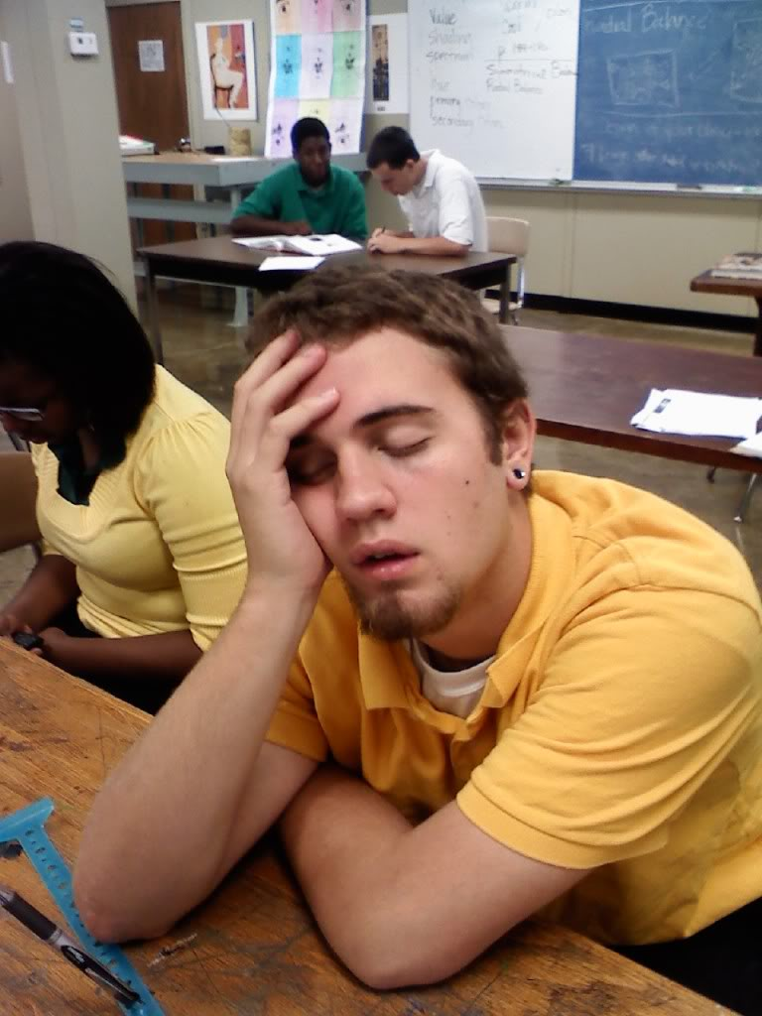
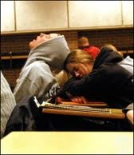
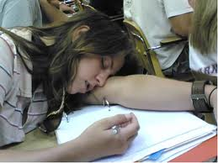
In school….
Hemingway enjoyed English but paid little attention to any other subjects.
He wrote for the school newspaper, boxed, and was somewhat of a bully

Slide 5
The Six Month Career
Ernest’s father wanted him to go to college, but he wanted to enlist or become a writer
He was forbidden to go to WWI, so he took a job as a journalist for The Kansas City Star
His departure from home to take this job is mentioned in our book when he refers to the mixed emotions he felt of sadness, relief, and adulthood.

Slide 6
The Six Month Career
While at the star, Hemingway learned some of the key elements of journalism and continued to use some of them in his novel writing:
Short sentences, vigorous English, positive wording, write about the way things are (don’t ramble about the way they might be)
Hemingway had a bad eye, and it was likely that he would not be accepted to the army.
He found and ad for ambulance drivers in the war before it went to press and applied. He qualified for this position and left after only six months.

Slide 7
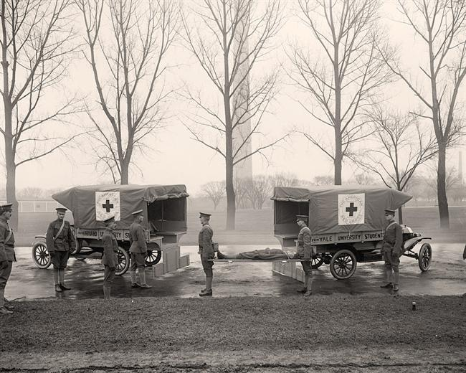
The Ambulance Driver
He was stationed in Italy in World War I. He was 18 years old.
Ambulance drivers were a vital part of this war.

Slide 8
The Ambulance Driver
As soon as he arrived, a factory exploded, and he was sent to carry the bodies to the morgue.
He wrote back to the Star, “I am considerably shocked by the work I am doing, especially finding women amongst the dead.”
Two days later he was sent to Vicenza which disappointed Hemingway who wanted to be part of the action.
He called his new assignment the Country Club and soon signed up for canteen duty to get back to the action.

Slide 9
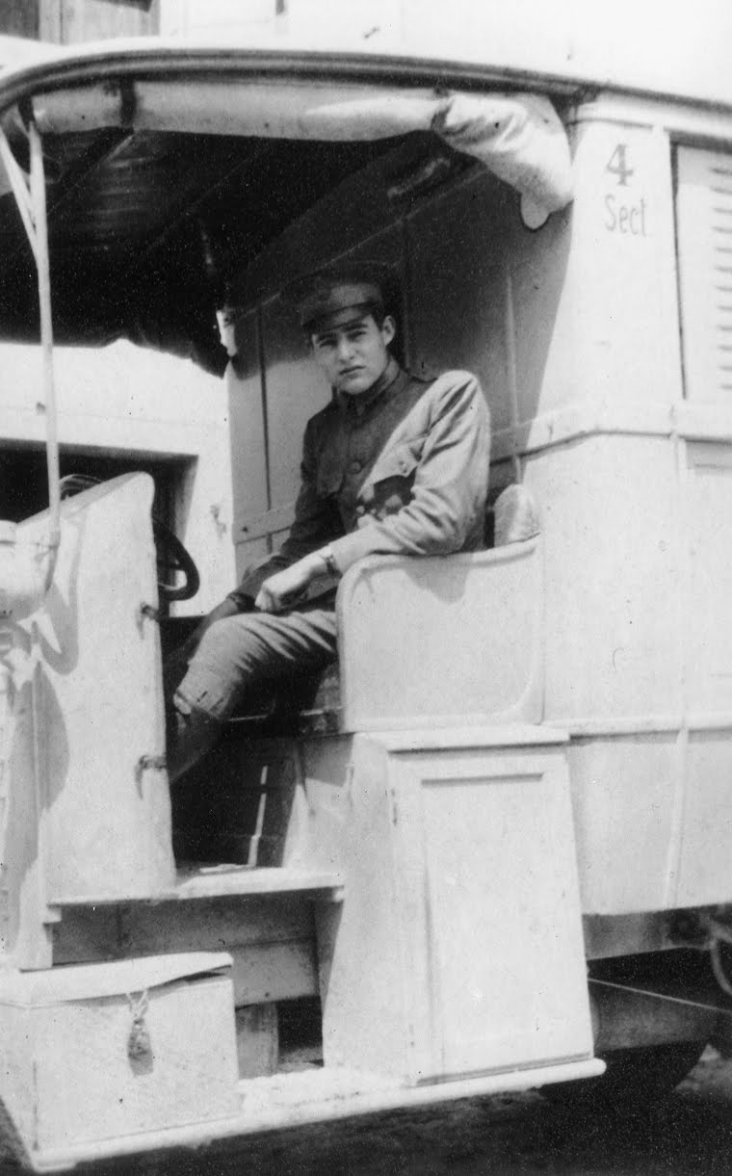
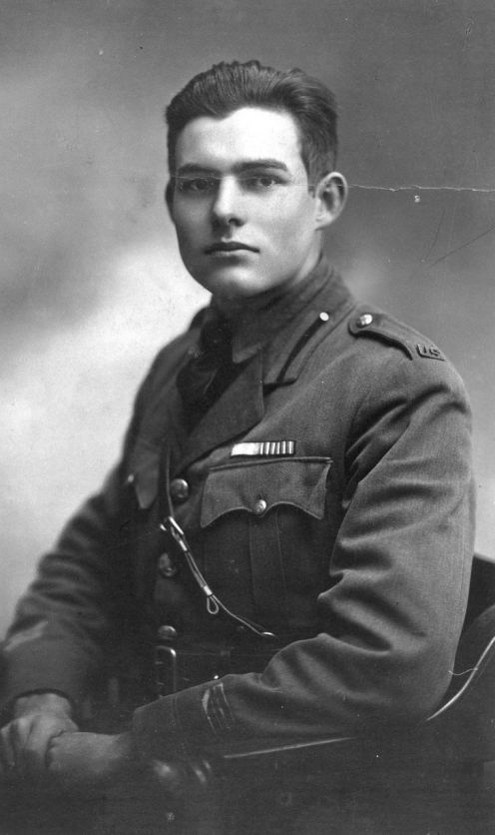
Canteen duty
His new assignment was to give out food to the soldiers. He was in the middle of the action again.
Six days before his nineteenth birthday, he was hit with Austrian artillery.

Slide 10
Lady # 1
Wounded Hemingway was able to carry another wounded soldier to safety before being hit by machine gun fire.
He laid there for 2 hours before being administered morphine and seen by a doctor.
The injured Hemingway was sent to Milan to a mansion with ten other wounded soldiers.
There were 18 Red Cross Nurses to look after them.

Slide 11
Lady # 1
Hemingway was popular with all the nurses, but he was particularly fond of Agnes Von Kurowsky from Washington.
Ernest was the hero of the hospital. He was the first American injured in Italy and had been injured heroically by carrying a wounded soldier. Agnes was admired by all, but Ernest won her affection.
Ernest wanted to marry Agnus, but she was older then him and decided it wouldn’t work. She called him “kid” – 19 and herself “Mrs. kid” - 26

Slide 12
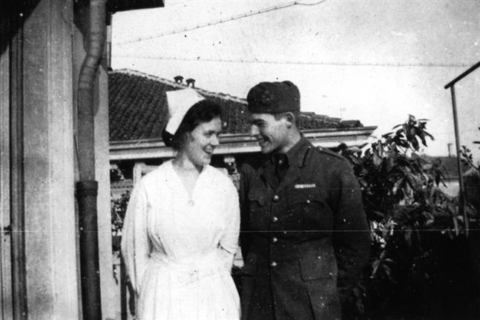
Lady #1
Agnes was his first love and appears in several of his writings including “A Farewell to Arms” – which is the story of their relationship.

Slide 13
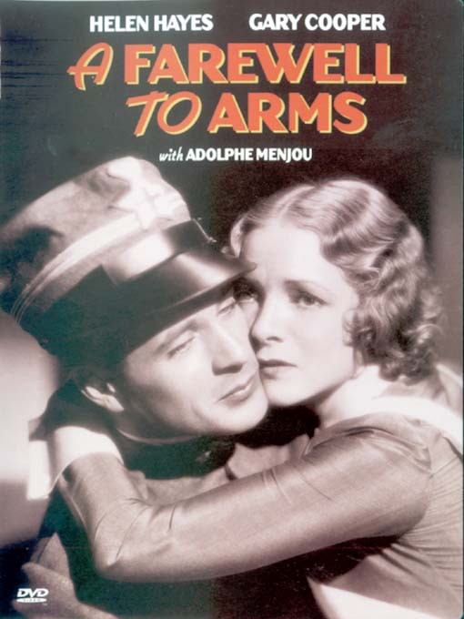
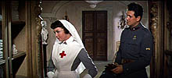
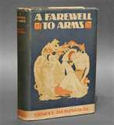
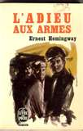
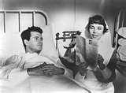
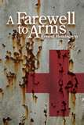
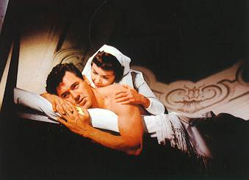

Slide 14
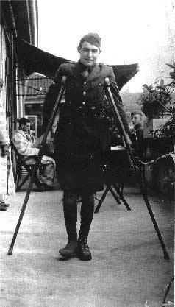
Back in America
Ernest tried to return to the war, but he had caught jaundice while in the war.
He returned to America with 227 scars on his leg.

Slide 15
Wife # 1 - Hadley
After leaving the ambulance service, he took a low paying journalism job. He was very depressed but soon met Elizabeth Hadley Richardson.
She was eight years older than him (28), but they married that year. She was naïve and inexperienced.
They were broke!

Slide 16
Wife # 1 - Hadley
They lived VERY modestly and saved enough money to visit Europe.
While there, he met Ezra Pound and Gertrude Stein who greatly influenced his work.
While with Elizabeth Hadley, Hemingway gained fame. They broke up due to his affair with Vogue editor Pauline Pfeiffer. He dedicated the The Sun Also Rises to Hadley and gave her the royalties from the book.

Slide 17
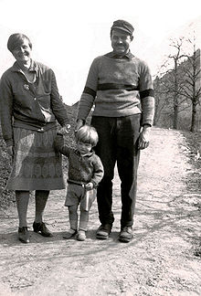
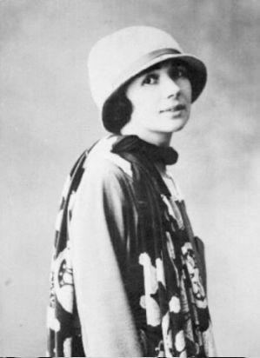
Hadley v. Pauline

Slide 18
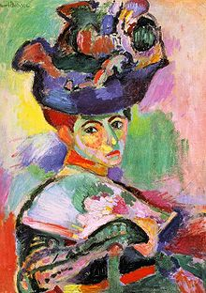
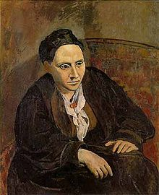
Gertrude Stein
Woman with a Hat by Matisse Portrait of Gertrude Stein by Picasso

Slide 19
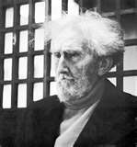
Ezra Pound
The first modern poet
Most famous work- The Cantos (unfinished)
He was also a mentor to T.S. Eliot

Slide 20
Wife # 2 - Pauline
Hadley would only grant Hemingway a divorce if he promised to live a part from Pauline for 6 months. If they were still in love, they could marry.
Without anyone, Hemingway became very depressed. He wrote of suicide.
In January he divorced Hadley. In May he married Pauline.

