Slide 1
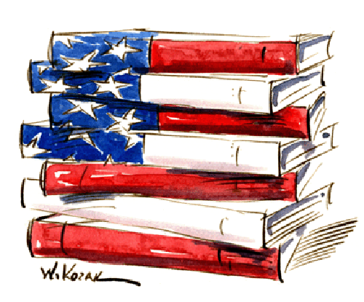
Welcome to American Literature!
Beginnings to 1900
You will need to add words in green
to your index cards

Slide 2
Discussion
What is American literature?
Does American literature have to be written by an American?
Does American literature have to be about America?
Can immigrants write American literature? Emigrants?
Did the first colonist in America write American literature, or did they still write the literature of the country they left, or did they write the literature of the country who owned the colony?

Slide 3
Who provided the first American literature?
The earliest American literature is in the form of Native American writing systems (Sanskrit) and oral tradition.

Slide 4
Oral Tradition Discussion
What do you think oral tradition is?
What might be some problems with this method of storytelling?
What might be some of the positive effects of this method of storytelling?
Who owns an oral story?
Do you know any stories that originated through oral tradition?
The Illiad, The Odyssey, Grimm’s Fairytales
What literary elements are important to oral tradition?

Slide 5
Myths
One important story that was passed down through oral tradition was a culture’s myths.
Myths- a story that relies on the supernatural to explain a natural phenomenon, an aspect of human behavior, or a mystery of the universe.
Creation myths tell how the world and human beings came to exist
Origin myths explain how natural phenomenon such as the stars, moon, and mountains came to be or why a society has certain customs or beliefs

Slide 6
Archetypes Activity
Archetype- a symbol, story pattern, or character type that is found in the literature of many cultures.
Myths often have archetypes.
Read the two Native American myths on your handout. What archetype do you see in these two myths?

Slide 7
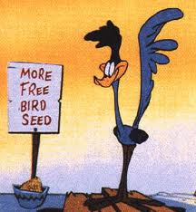
The Trickster
The trickster character type is often an animal- such as a coyote, a raven, or a mink- that speaks and displays other human traits
Tricksters often defy authority and cause trouble, but they are also clever and creative and reveal wisdom

Slide 8
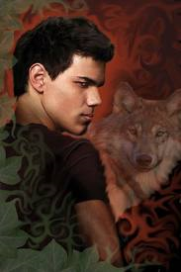
The Totem
In many Native American cultures, each family group, or clan, believed it descended from a particular animal or other natural object, called the totem.
The clans would preserve the myths of the totem.

Slide 9
What else do you find in Native American Literature?
Native Americans had great reverence for the natural world and the creatures in it. They saw the natural cycle of life as sacred.
Because nature was sacred, it could not be owned.
The first American literature was told by Native Americans some 40,000 years ago.

Slide 10
Tomorrow
Before you read, use the information on page 22 of your book to complete your handout.
The literature for this lesson can be found on page 24 of your book, “How the World was Made.”
HOMEWORK: Write an origin myth for the moon involving a trickster.

