Slide 1
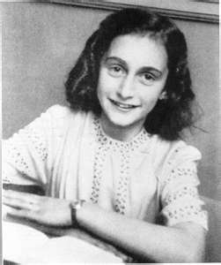
A= Anne Frank
A thirteen year old Jewish girl who had to grow up hiding in an attic because of the threat of the Nazi Regimen.

Slide 2
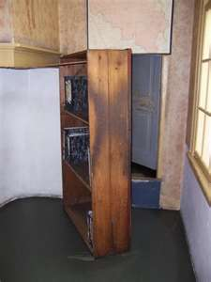
B = Bookshelf
Anne and her family lived in an attic hid behind a bookshelf/secret door.

Slide 3
C = Concentration Camp
Prisons used without any regard to how and why people were arrested or detained.
Death, Disease, Starvation, Crowded and Unsanitary Conditions, and Torture were a common aspect of Concentration Camps during the Holocaust.

Slide 4
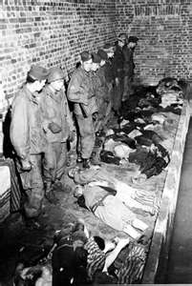
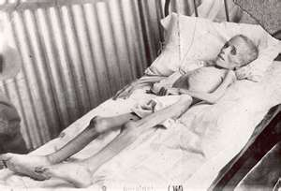
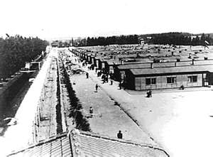
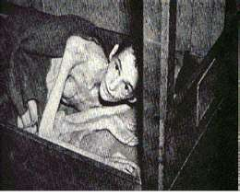

Slide 5
D = Death Camps
Nazi extermination camps were Jews and other undesirables were brought to be killed as part of Hitler’s final solution.

Slide 6
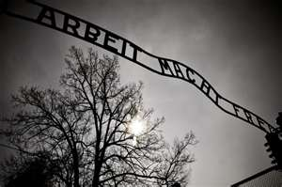
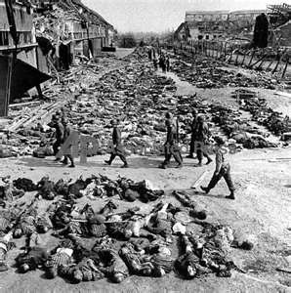
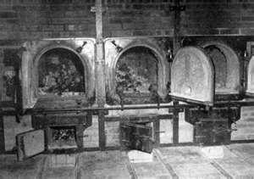
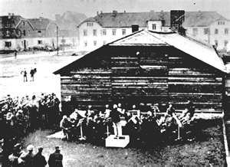

Slide 7
E = Eleven Million
The number of people killed during the Holocaust.
That’s the population of Alabama, Mississippi, and Louisiana combined!

Slide 8
F = Fascism
A social and political idea that the most important guiding principle is the state of the nation and not the individual.
Many Nazi’s believed that the Jews were making their country weak.

Slide 9
G = Gas Chambers, Ghettos, and Genocide
Gas Chambers- In the death camps, many people were placed in a room which was then filled with gas as a means of extermination.
Ghettos- The Jews were forced to relocate to areas that were heavily guarded, poor, and overcrowded
Genocide- The destruction of a racial, political, cultural, or religious group

Slide 10
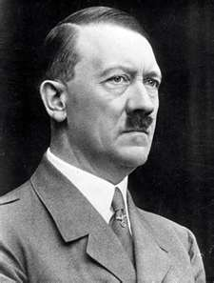
H = Hitler
Leader of the Nazi party and brilliant propagandist.

Slide 11
I = International Military Tribunal
Court established by United States, Great Britain, France, and Union of Soviet Socialist Republic to prosecute Nazi war criminals.

Slide 12
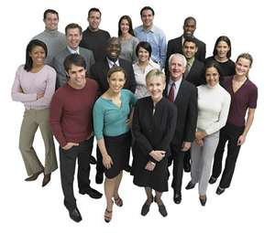
J = Jews
Six million out of the eleven million people killed during the Holocaust were Jews.
Jews believe in the Old Testament of the Bible. It is a religion not race.

Slide 13
K = Kristallnacht
The Night of Broken Glass
The Nazis destroyed almost 200 synagogues, 8,000 Jewish shops, and sent tens of thousands of Jewish men to concentration camps in one night.

Slide 14
N = Nuremberg Laws and Nazi
The Nuremberg Laws defined “Jew” and severely limited the Jew’s rights.
Nazi- a political party based on strong military, anti-Semitic, racial, and national ideas.

Slide 15
O = Operation Reinhard
Code name for the Final Solution
Final solution- plan to kill all Jews.

Slide 16
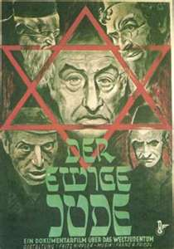
P = Propaganda
False or partially false information used to sway the opinions of a population.

Slide 17
R = Resettlement
Euphemism used by the Nazis to discuss the relocation of Jews to concentration camps

Slide 18
S = Star of David
Jews were required to wear a Star of David on their sleeve at all times to identify themselves.

Slide 19
T = Treaty of Versailles
Treaty after World War I. It disarmed Germany, forced Germany to pay large sums of money and give up great tracts of land.
Hitler wanted to bring Germany back to power.

Slide 20
W = Warsaw Ghetto
Before- Warsaw had almost a 30% Jewish population/near 350,000 Jews.
After- The Nazi’s forced all of the Jews in Warsaw and many in the outskirts to move to a Warsaw Ghetto. 400,000 Jews lived in 1.3 miles.

