Slide 1
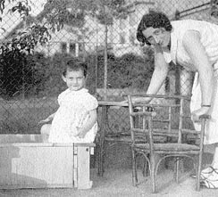
Anne and her mother Edith before the War

Slide 2
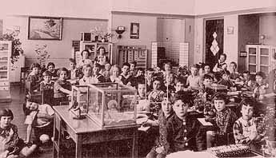
Anne’s Montessori School before being sent to a Jewish School

Slide 3
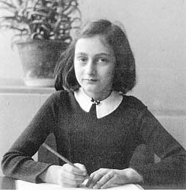
Anne in Holland before going into Hiding

Slide 4
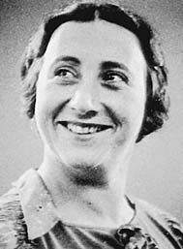
Edith Frank

Slide 5
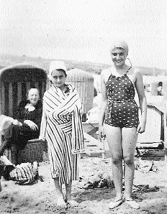
Anne and Margot one year before the Invasion of Netherland

Slide 6
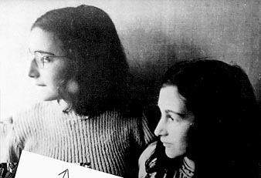
Last Picture of Margot and Anne

Slide 7
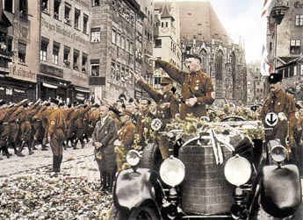
Hitler gathering Support

Slide 8
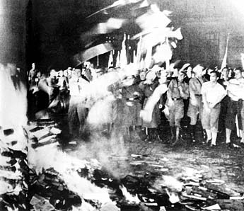
Nazis burned books and changed history

Slide 9
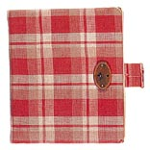
The diary Anne received for her 13th Birthday

Slide 10
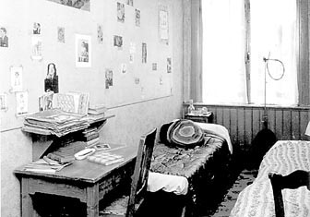
Anne’s Room- notice the pictures of movie stars on the wall

Slide 11
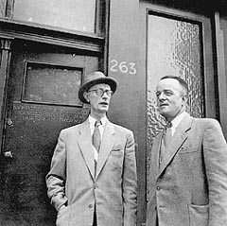
Mr. Kleiman and Mr. Kugler visited the Frank’s during their lunch hour while the worker’s were at home.

Slide 12
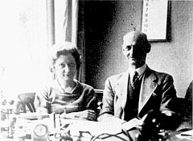
Miep and Jan Gies

Slide 13
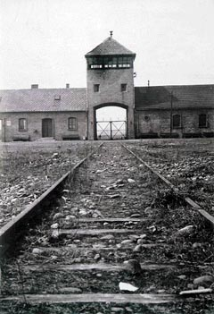
The Concentration Camp where Edith died of Starvation and Exhaustion

Slide 14
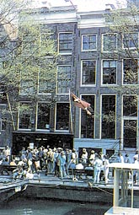
The Annex is now a Museum

Slide 15
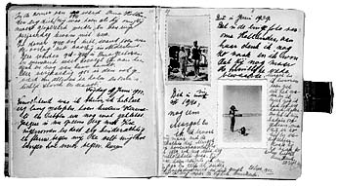
Picture from the Diary

Slide 16
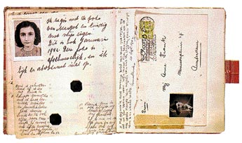
The Diary

Slide 17
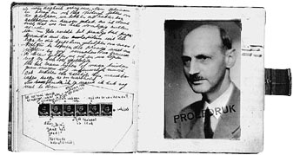
Mr. Frank never read the diary until after Anne’s death

Slide 18
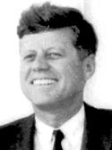
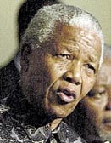
John F. Kennedy
"Of the multitude who throughout human history have spoken for human dignity in times of great suffering and loss, no voice is more compelling than that of Anne Frank."
Nelson Mandela
"Some of us read Anne Frank's diary on Robben Island and derived much encouragement of it." - Nelson Mandela

Slide 19
After the Nazi invasion of the Netherlands in May 1940, the Dutch people were immediately faced with the question of choice: how to respond to the Nazi occupation. Tens of thousands of Dutch people followed Hitler, and millions more looked the other way. Eventually, a resistance movement began to grow. The Nazis needed Dutch collaborators to carry out their fascist decrees. What would have influenced someone to become a collaborator? What factors would have encouraged someone to join the resistance? Do you think these factors were based on personal characteristics or political beliefs? What was the price of resistance during the war? What was the price of collaboration?

Slide 20
2. Anne Frank and her family were German refugees who resettled and tried to build their lives in the Netherlands. Although the Franks were proud of their German heritage, their feelings toward Germany became very complicated during the war. Anne wrote: "Fine specimens of humanity, those Germans, and to think I'm actually one of them! No. that's not true, Hitler took away our nationality long ago. And besides, there are no greater enemies on earth than the Germans and Jews." (October 9, 1942.) Although Anne had lived in the Netherlands since 1934, she did not become a Dutch citizen. Did Anne have a nationality? If not, were Anne's civil rights protected by any nation? By 1939 some 250,000 Jews, half of Germany's Jewish population, had fled their homeland. Did these refugees have any guaranteed rights? After the war Otto Frank responded to references to "the Germans" by asking "which German?" He believed strongly that blaming all Germans was another form of stereotyping. What constitutes a stereotype? How is a stereotype different from discrimination?

Slide 21
3. In The New York Times the writer Anna Quindlen asked, "Would our understanding of the Holocaust be quite the same if Anne Frank had not taken a small plaid diary into hiding with her?" What has most shaped your understanding of World War II: personal experience, Anne's diary, popular films such as Schindler's List, newsreel footage, academic or historical texts?

Slide 22
4. Otto Frank chose to edit out some of the negative comments Anne made about her mother and a number of the other residents of the Secret Annex--comments that have been restored in the new translation by Susan Massotty. He believed that Anne would have wanted him to do so. Do you think he was correct?

Slide 23
6. Are there certain characteristics common among those few individuals who risked their own lives to rescue Jews during World War II? Why do so many of them deny their own heroism?

