Slide 1
Before we begin:
In one of her diary entries, Anne tells us that Margot is also keeping a diary. Write a 100 word diary entry from the point of view of one of the other characters in the play.
Characters: Margot, Peter, Mr. Frank, Mrs. Frank, Mrs. Van Daan, Mr. Van Daan, Miep, Mr. Kraler, Mr. Dussell

Slide 2
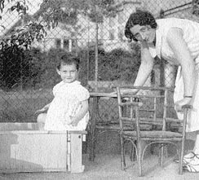
Anne and her mother Edith before the War

Slide 3
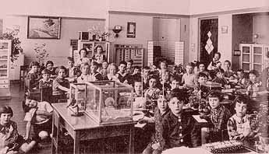
Anne’s Montessori School before being sent to a Jewish School

Slide 4
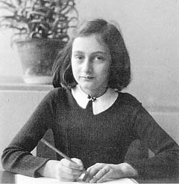
Anne in Holland before going into Hiding

Slide 5
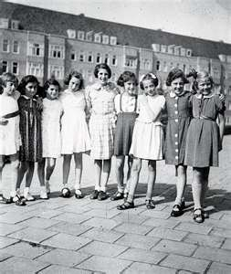
Anne had lots of friends

Slide 6
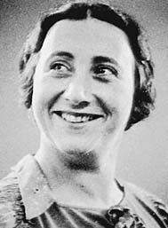
Edith Frank

Slide 7
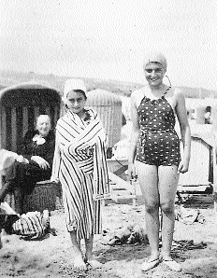
Anne and Margot one year before the Invasion of Netherland

Slide 8
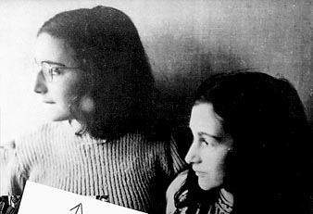
Last Picture of Margot and Anne

Slide 9
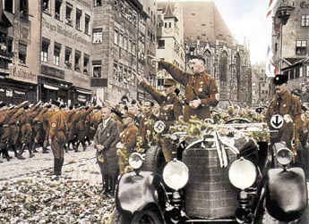
Hitler gathering Support

Slide 10
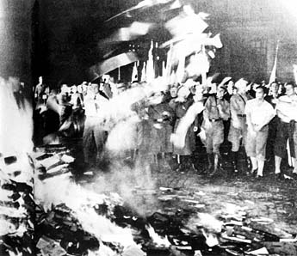
Nazis burned books and changed history

Slide 11
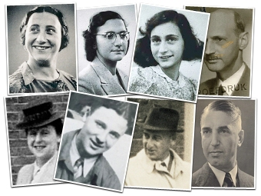
Who’s Who?

Slide 12
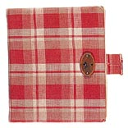
The diary Anne received for her 13th Birthday

Slide 13
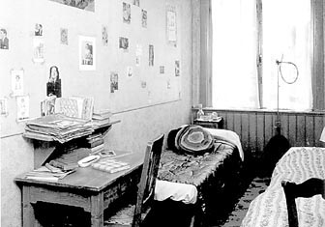
Anne’s Room- notice the pictures of movie stars on the wall

Slide 14
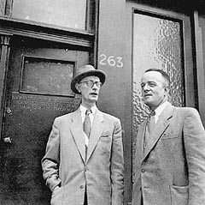
Mr. Kleiman and Mr. Kugler visited the Frank’s during their lunch hour while the worker’s were at home.

Slide 15
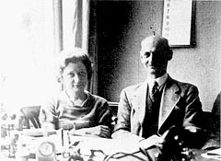
Miep and Jan Gies

Slide 16
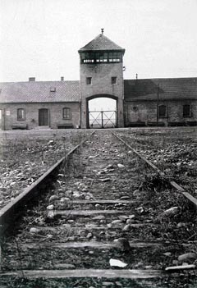
The Concentration Camp where Edith died of Starvation and Exhaustion

Slide 17
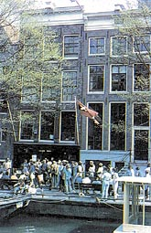
The Annex is now a Museum

Slide 18
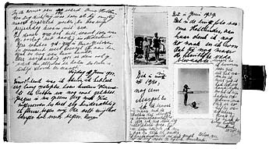
Picture from the Diary

Slide 19
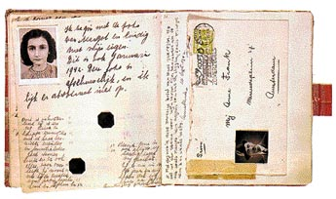
The Diary

Slide 20
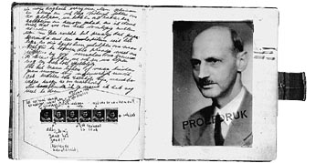
Mr. Frank never read the diary until after Anne’s death

Slide 21
3D HOUSE
http://www.annefrank.org/en/Subsites/Home/Enter-the-3D-house/#/house/29/

Slide 22
What happen to them?
http://www.annefrank.org/en/Subsites/Home/Enter-the-3D-house/#/house/0/hotspot/5481/video/

Slide 23
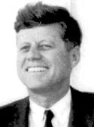
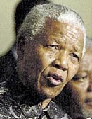
John F. Kennedy
"Of the multitude who throughout human history have spoken for human dignity in times of great suffering and loss, no voice is more compelling than that of Anne Frank."
Nelson Mandela
"Some of us read Anne Frank's diary on Robben Island and derived much encouragement of it." - Nelson Mandela

Slide 24
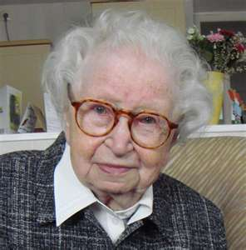
Ask Miep…10 questions you would have liked to ask Miep before her death last year.

