Slide 1
Sonnet # 18
Shall I compare thee to a summer’s day?
Thou art more lovely and more temperate:
Rough winds do shake the darling buds of May,
And summer’s lease hath all too short a date:
Sometime too hot the eye of heaven shines,
And often is his gold complexion dimmed;
And ever fair from fair sometime declines,
By chance, or nature’s changing course, untrimmed:
But thy eternal summer shall not fade,
Nor lose possession of that fair thou ow’st,
Nor shall death brag thou wander’st in his shade
When in eternal lines to time thou grow’st:
So long as men can breathe or eyes can see,
So long lives this, and this gives life to thee.

Slide 2
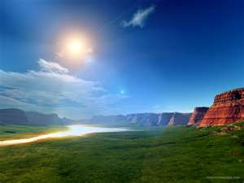
Shall I compare thee to a summer’s day?

Slide 3
Thou art more lovely and more temperate:

Slide 4
Rough winds do shake the darling buds of May

Slide 5
An summer’s lease hath all too short a date

Slide 6
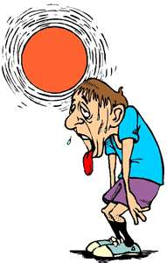
Sometime too hot the eye of heaven shines

Slide 7
And often is his gold complexion dimmed

Slide 8
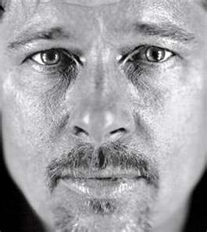
And every fair from fair sometimes declines

Slide 9
By chance, or nature’s changing course, untrimmed

Slide 10
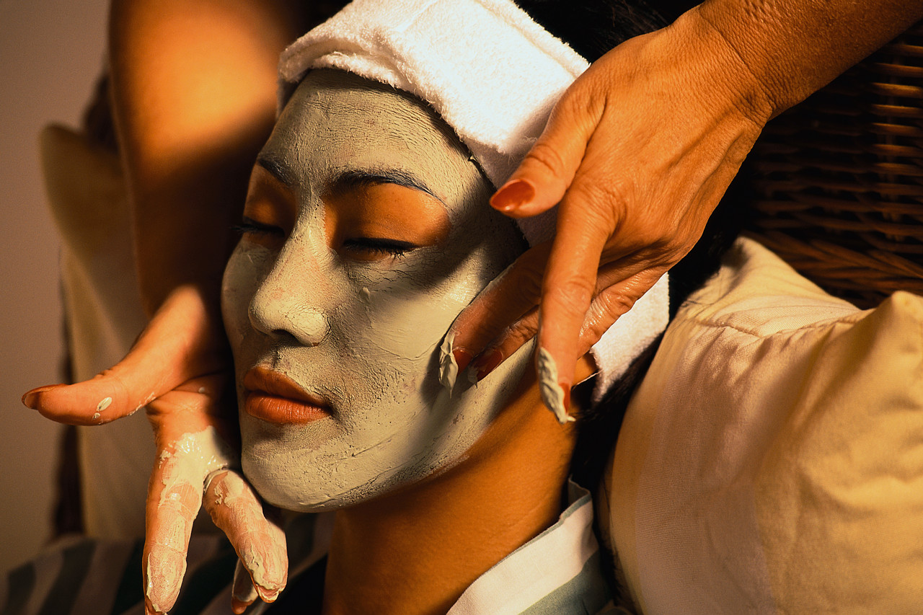
But thy eternal summer shall not fade

Slide 11
Nor lose possession of that fair thou ow’st

Slide 12
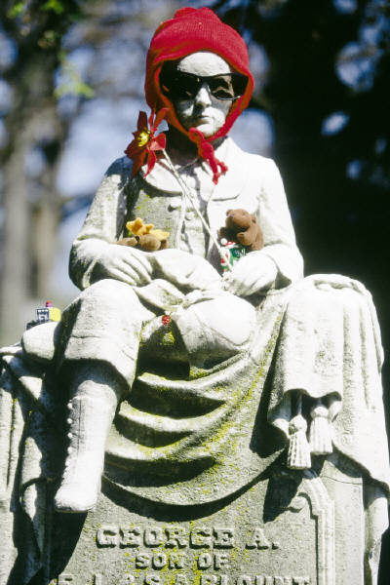
Nor shall death brag thou wander’st in his shade

Slide 13
When in eternal lines to time thou grow’st

Slide 14
So long as men can breathe or eyes can see

Slide 15
So long lives this, and this gives life to thee

Slide 16
Group One
Using # 18 as a model, determine the rhyme scheme of a Shakespearean or English sonnet
A= First rhyme
B= Second rhyme, etc.
Also label any inside line rhymes

Slide 17
Group Two
Using # 18 as a model, determine the number of lines and the overall structure of a Shakespearean sonnet
Couplet = 2 lines
Quatrain = 4 lines
Tercet = 3 lines
Octave = 8 lines
Sestet = 6 lines

Slide 18
Group Three
Using # 18 as a model, determine the meter of a line of a Shakespearean sonnet
Iamb = unaccented followed by accented
Meters are
1 = monometer
2 = dimeter
3 = trimeter
4 = tetrameter
5 = pentameter

Slide 19
Group Four
Using # 18 as a model, determine the subject of a Shakespearean sonnet.
What themes are discussed?
Art
Beauty
Love
Life
Death, etc.

Slide 20
Write a sonnet
Write an English sonnet about a frog and a princess
Rhyme Scheme= abab, cdcd, efef, gg
Structure= 3 quatrains and a couplet
Meter= iambic pentameter
Subject= love, time, death, unrequited love

Slide 21
Is this an English sonnet?
Two households, both alike in dignity,
In fair Verona, where we lay our scene,
From ancient grudge break to new mutiny,
Where civil blood makes civil hands unclean.
From forth the fatal loins of these two foes
A pair of star-crossed lovers take their life;
Whose misadventured piteous overthrows
Doth with their death bury their parents’ strife.
The fearful passage of their death-marked lvoe,
And the continuance of their parents’ rage,
Which, but their children’s end naught could remove,
Is now the two hours’ traffic of our stage;
The which if you with patient ears attend,
What here shall miss, our toil shall strive to mend.

